Slide 1

North South University
Department of Electrical and Computer Engineering
Spring, 2021
CSE 499A
Section - 7

Slide 2

Online Class & Examination Monitoring System
Group Members
Galib Faruk Gani
Rubaida Ferdous
Md Sharif Hossain
Kazi Moshiur Rahaman

Slide 3
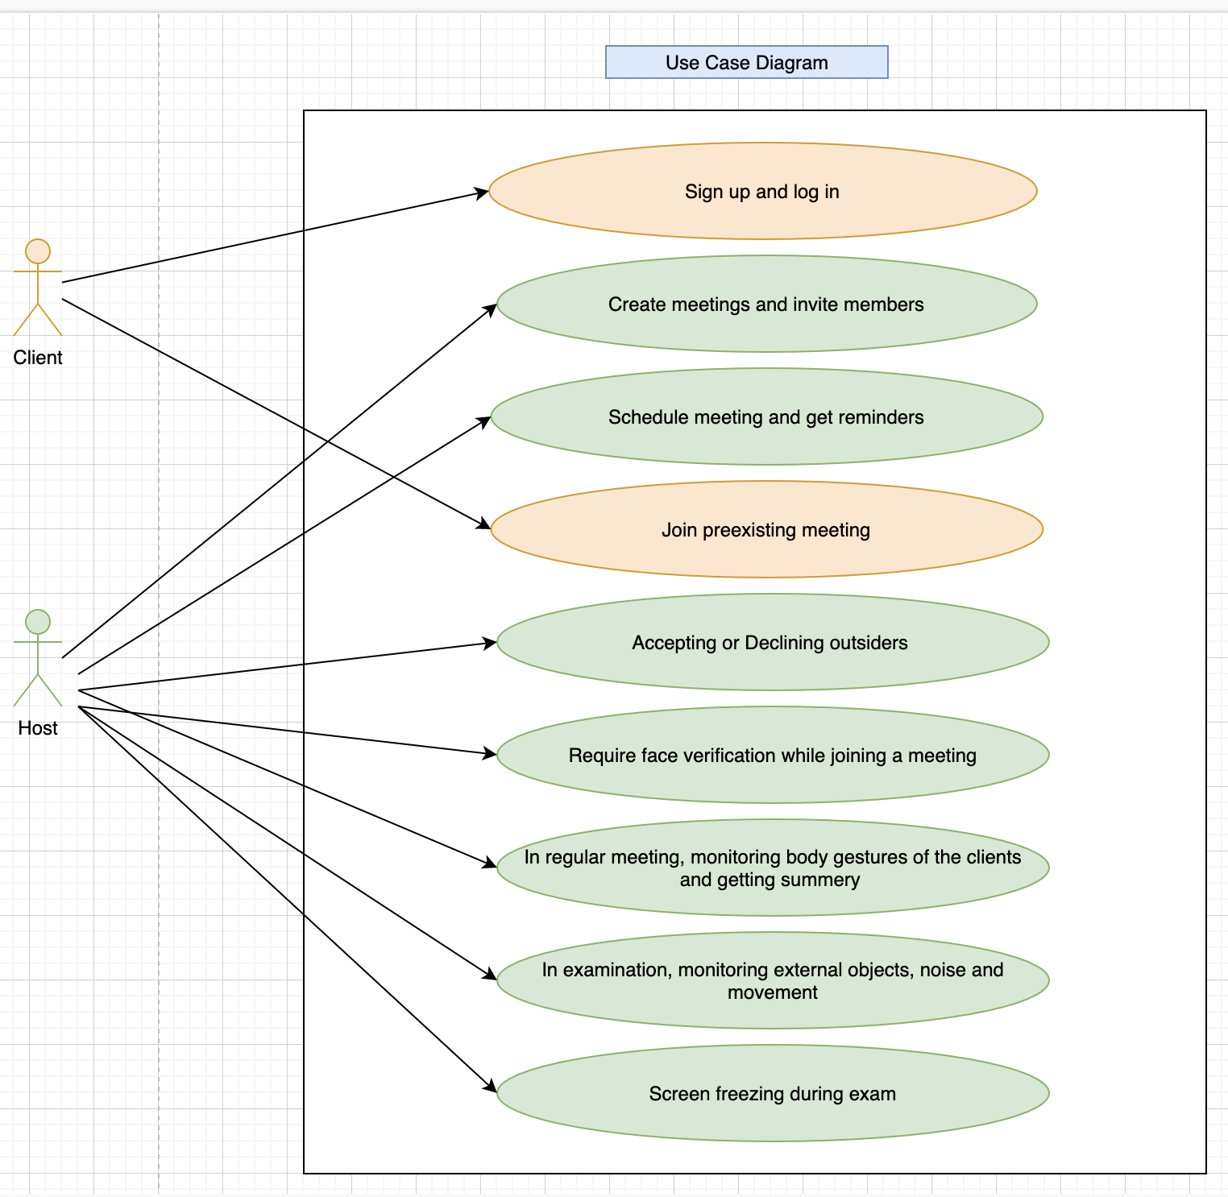
Use Case Design

Slide 4
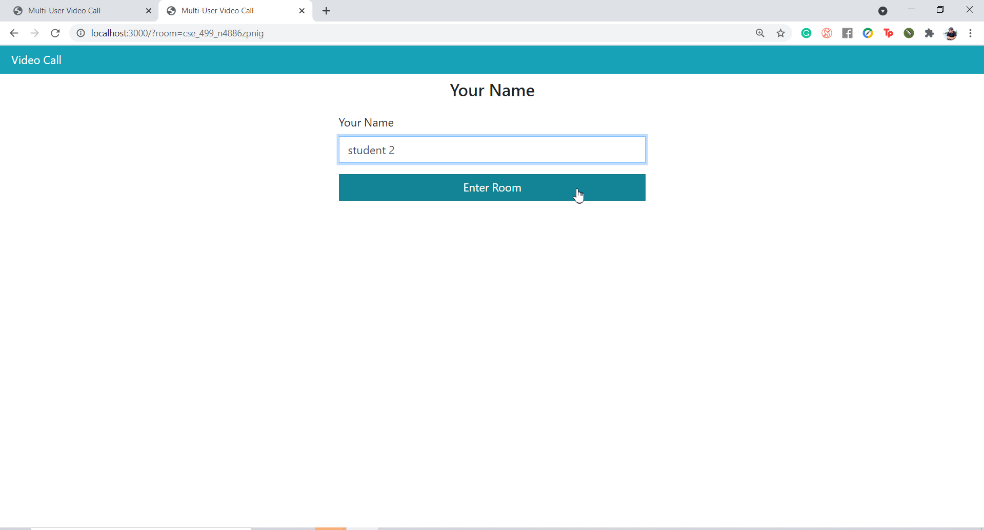
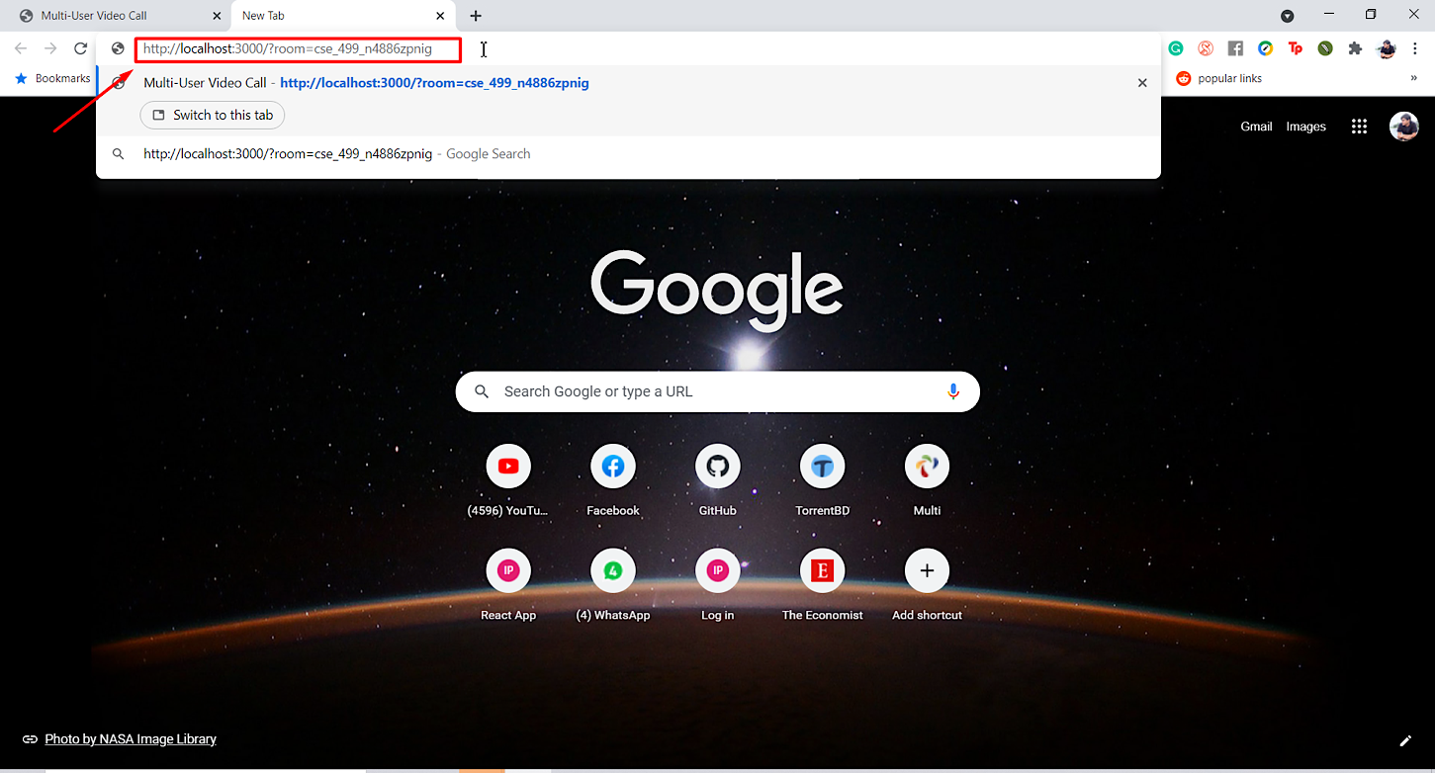
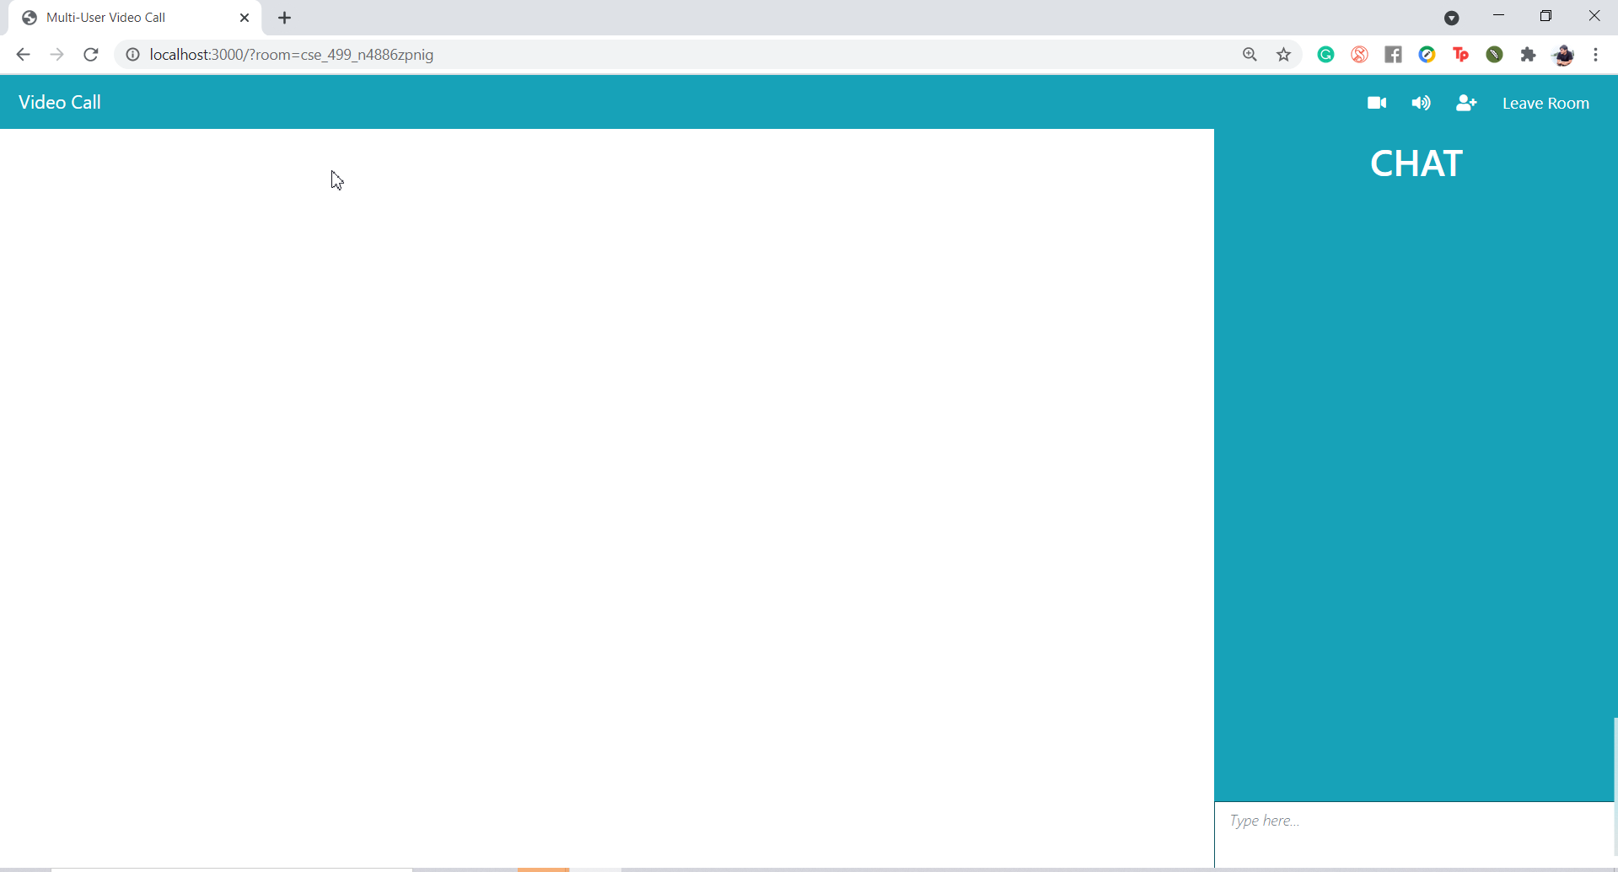
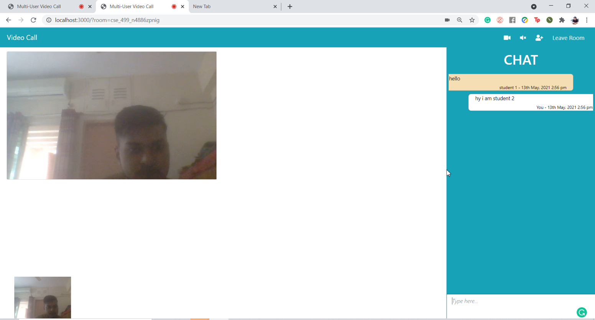
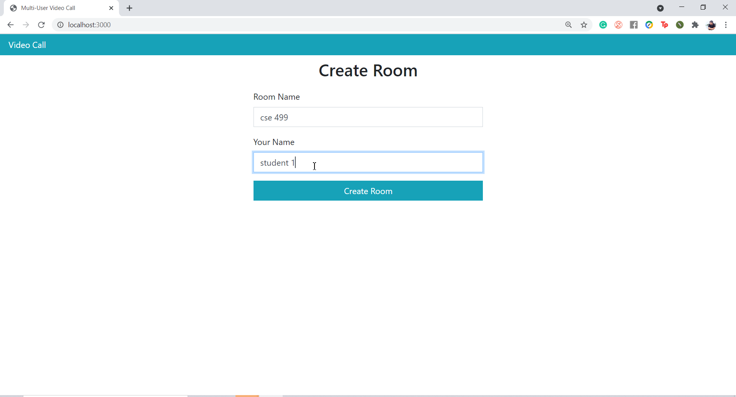
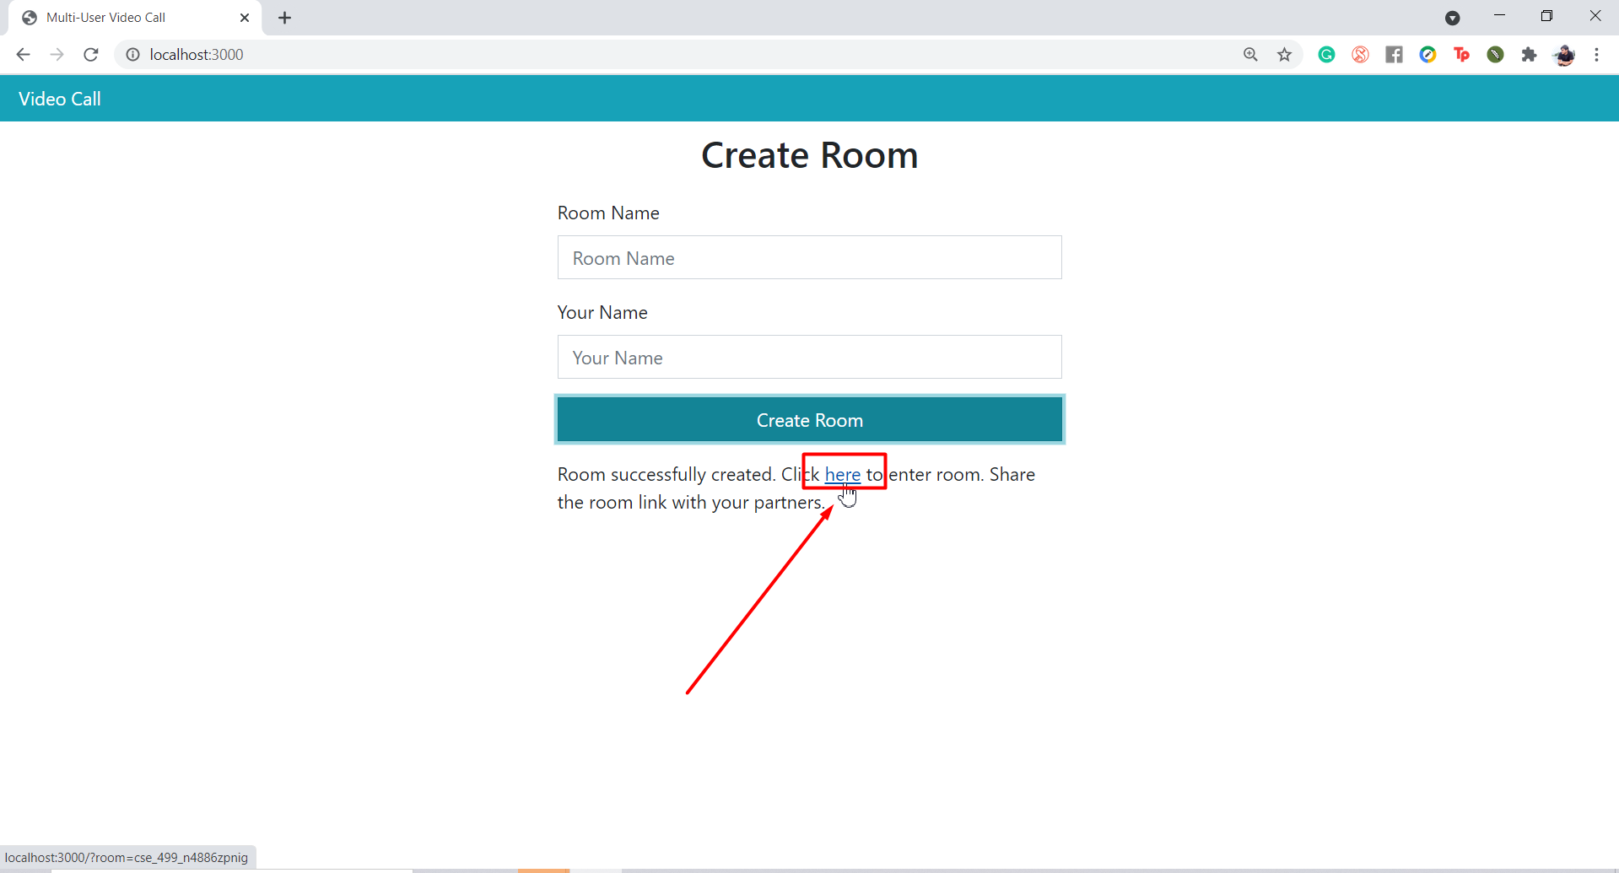
How it works?

Slide 5
Team Contributions
This project needed more research time rather than hard coding. We needed to use open source solution parts for our project. Teamwork helped to research from the huge source of internet and find a considerable solution set.
Work distribution: Galib Faruk Gani (GG), Rubaida Ferdous (RF), Md Sharif Hossain (SH), Kazi Moshiur Rahaman (KR)
Tasks | Responsibilities
Problem Analysis | GG, RF, SH, KR
Project proposal | GG, RF, SH, KR
Solution Analysis | GG, RF, SH, KR
Functional Analysis and use case diagram | RF, SH, KR
Video conference analysis research | GG, RF, SH, KR
Video conference implementation | SH, KR
Face recognition analysis research | GG, RF, SH, KR
Face recognition implementation | GG, RF, SH, KR (Ongoing)

Slide 6
Result Analysis
The problem was to monitor activities and identity over video conference during online class and examination.
We are still trying to address some of those problems. We have established a video conferencing tool and trying to implement an appropriate face & object detection tool with it.

Slide 7
Future Works
Completing face recognition, activities monitoring and object detection parts.
Improving frontend view.
Sharing video conference link via different platforms.
Working on more security functions to make the meeting service more secured.
Thanks to all!

